Slide 1

Цифровая и микроконтроллерная техника
Vlasov Sergey
smvlasov@itmo.ru

Slide 2
General-purpose I/O
Main features
Up to 16 I/Os under control
Output states: push-pull or open drain + pull-up/down
Output data from output data register (GPIOx_ODR)
Speed selection for each I/O
Input states: floating, pull-up/down, analog
Input data to input data register (GPIOx_IDR)
Bit set and reset register (GPIOx_BSRR) for bitwise write access to GPIOx_ODR
Locking mechanism (GPIOx_LCKR) provided to freeze the I/O configuration
Analog function
Alternate function input/output selection registers (at most 16 AFs per I/O)
Fast toggle capable of changing every two clock cycles
Highly flexible pin multiplexing allows the use of I/O pins as GPIOs or as one of several peripheral functions

Slide 3
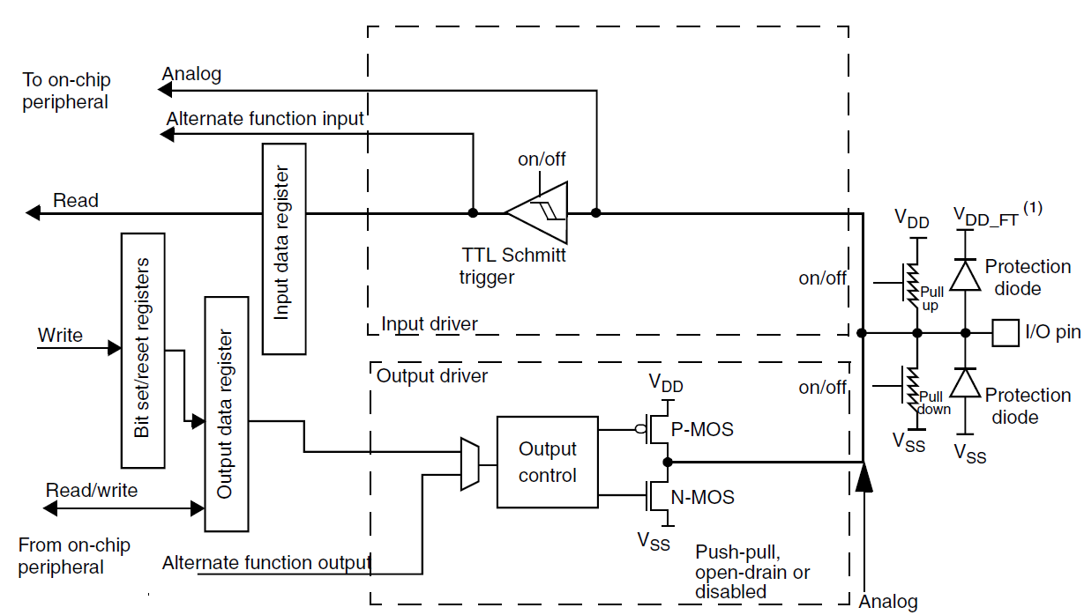
General-purpose I/O
Modes
00: Input
01: Output
10: AF
11: Analog

Slide 4
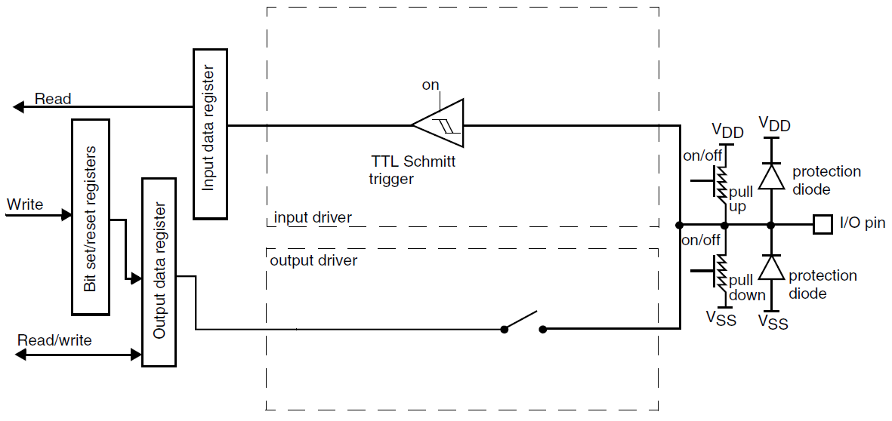
General-purpose I/O
Input configuration (00)

Slide 5
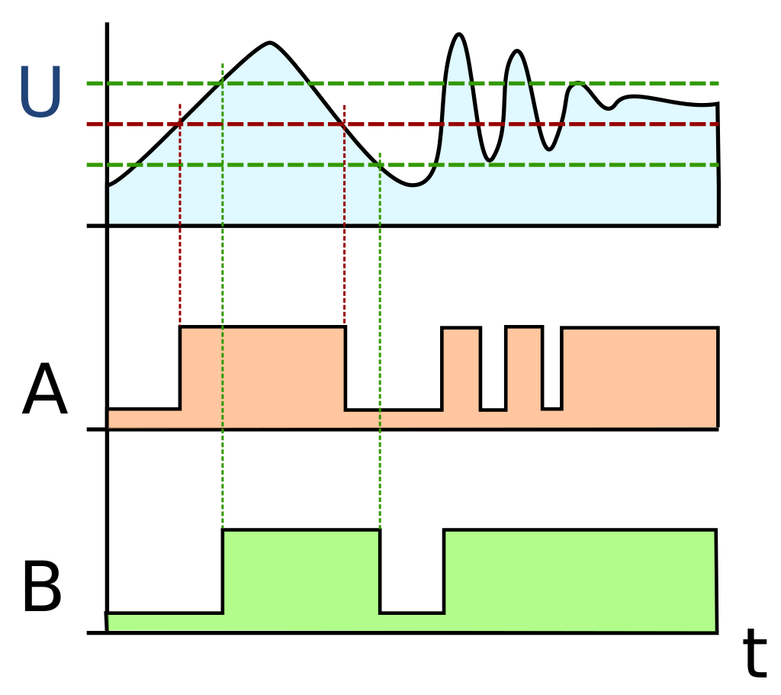
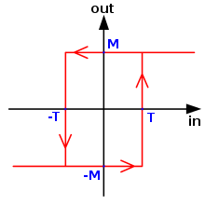
General-purpose I/O
TTL Schmitt trigger

Slide 6
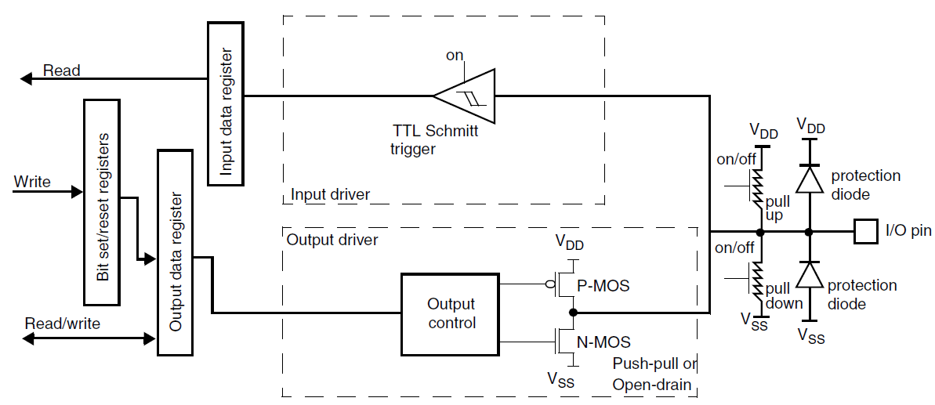
General-purpose I/O
Output configuration (01)

Slide 7
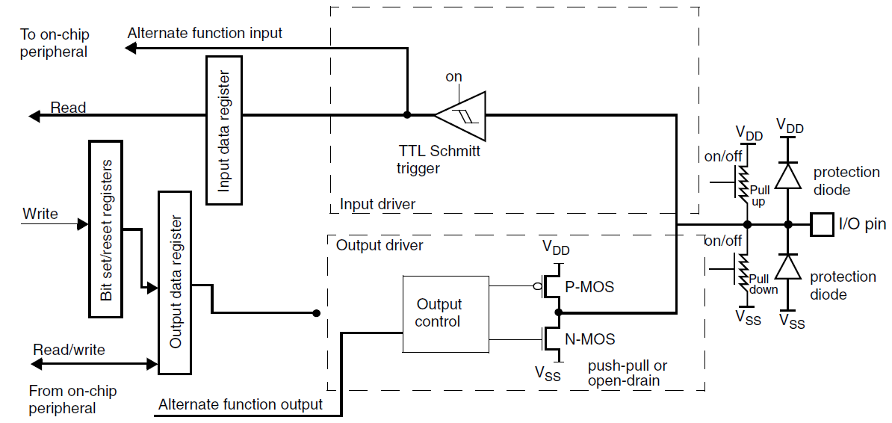
General-purpose I/O
Alternate function configuration (10)

Slide 8
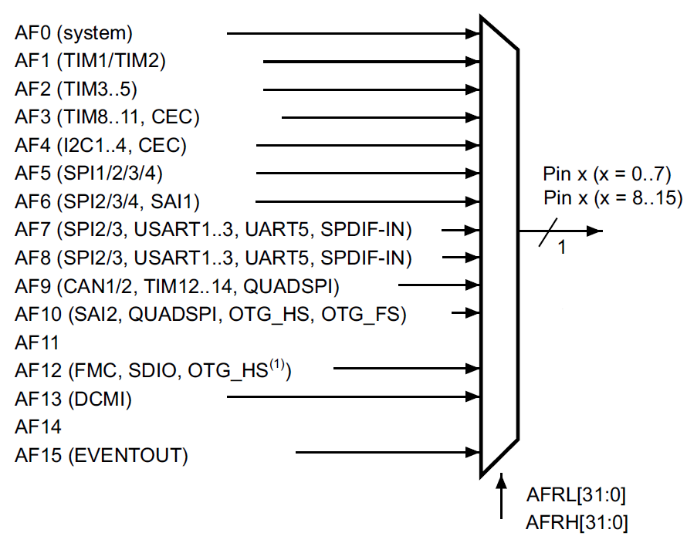
General-purpose I/O
Selecting an alternate function
Port |  | AF0 SYS | AF1 TIM1/2 | Afn …
PORTA | PA0 | - | TIM2_CH1/ TIM2_ETR | …
 | PA1 | - | TIM2_CH2 | …
 | PAn | - | TIM2_CH3 | …
… | … | … | … | …

Slide 9
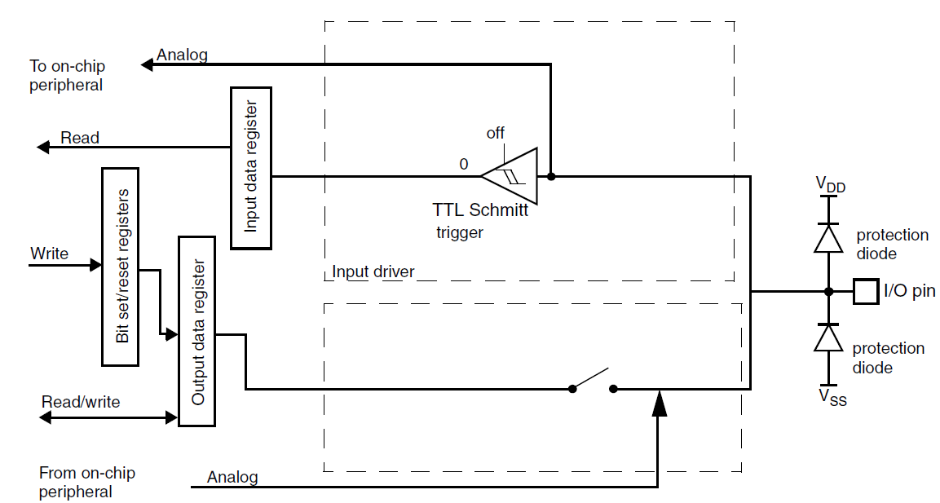
General-purpose I/O
Analog configuration (11)

Slide 10
General-purpose I/O
Registers
GPIO port mode register (GPIOx_MODER)
GPIO port output type register (GPIOx_OTYPER)
GPIO port output speed register (GPIOx_OSPEEDR)
GPIO port pull-up/pull-down register (GPIOx_PUPDR)
GPIO port input data register (GPIOx_IDR)
GPIO port output data register (GPIOx_ODR)
GPIO port bit set/reset register (GPIOx_BSRR)
GPIO port configuration lock register (GPIOx_LCKR)
GPIO alternate function register (GPIOx_AFR)

Slide 11
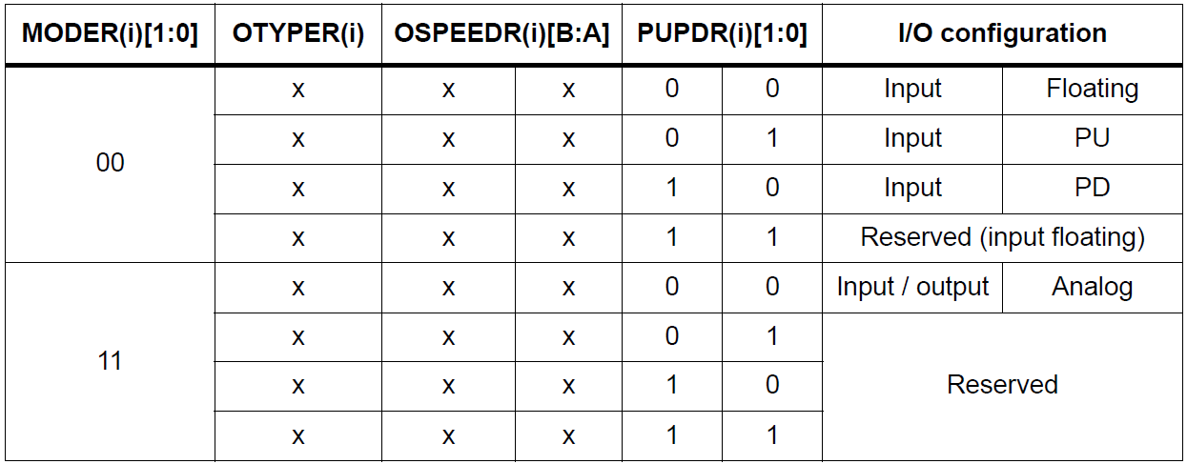
General-purpose I/O

Slide 12
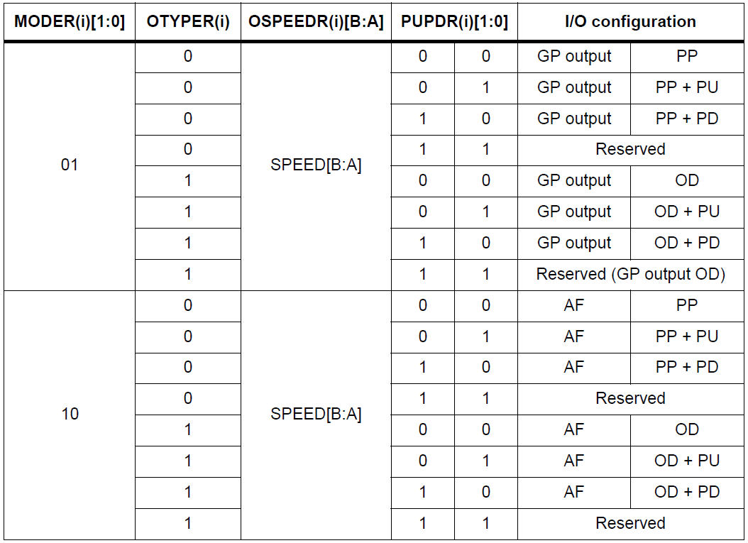
General-purpose I/O

Slide 13
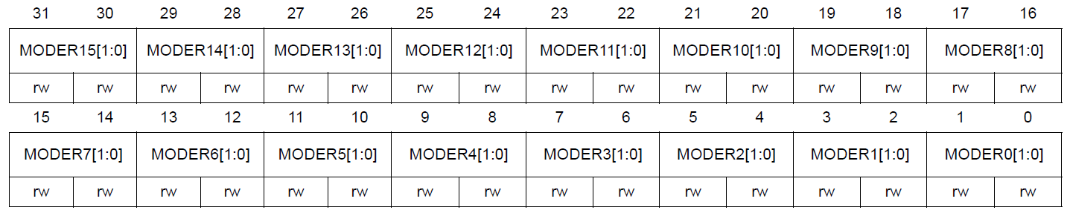
General-purpose I/O
GPIO port mode register (GPIOx_MODER)
Address offset: 0x00
MODERy[1:0]: Port x configuration bits (y = 0..15)
These bits are written by software to configure the I/O direction mode.
00: Input (reset state)
01: General purpose output mode
10: Alternate function mode
11: Analog mode

Slide 14
General-purpose I/O
GPIO port input data register (GPIOx_IDR)
Address offset: 0x10
GPIO port output data register (GPIOx_ODR)
Address offset: 0x11

Slide 15
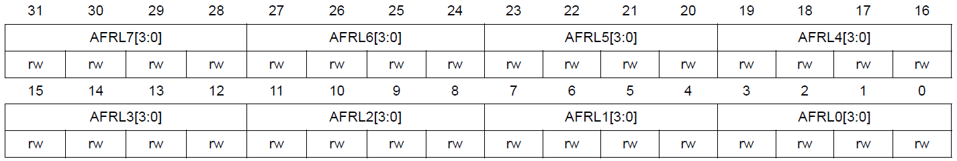
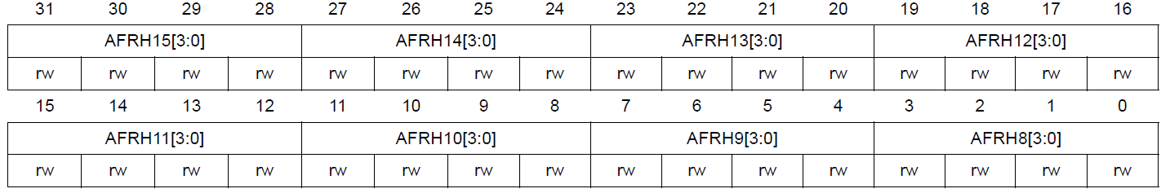
General-purpose I/O
GPIO alternate function L/H register (GPIOx_AFR[2])
Address offset: 0x20, 0x24
AFRHy: Alternate function selection for port x bit y (y = 8..15)
0000: AF0
0001: AF1…

Slide 16
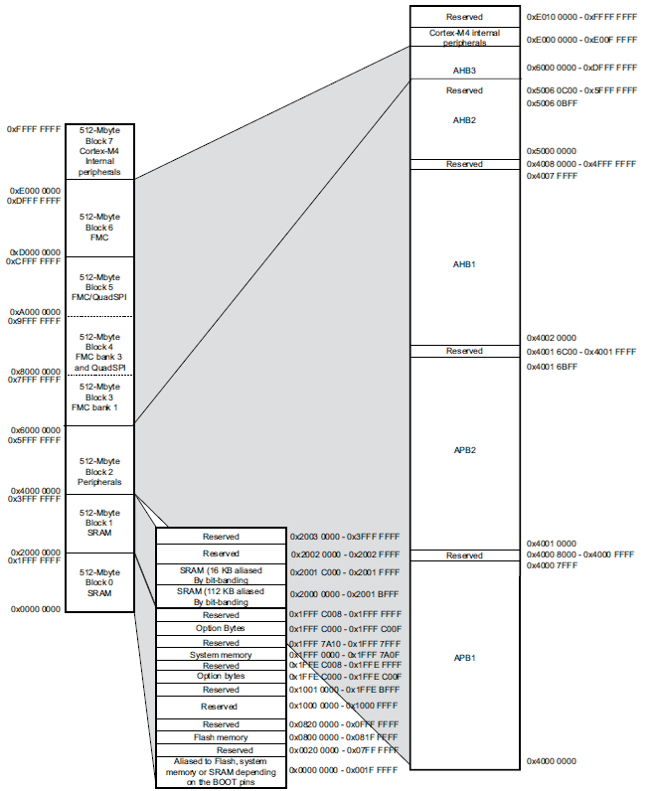
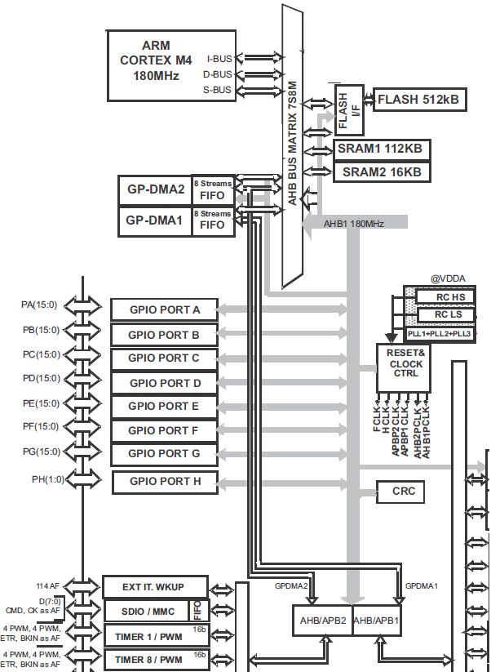
ARM Cortex-M

Slide 17
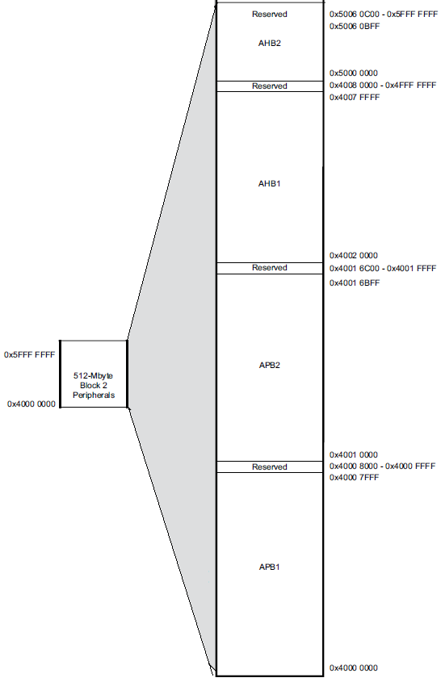

ARM Cortex-M
Work with registers
PERIPH_BASE = 0x4000 0000

Slide 18
ARM Cortex-M
Work with registers
PERIPH_BASE = 0x4000 0000
APB2PERIPH_BASE = PERIPH_BASE + 0x1 0000

Slide 19
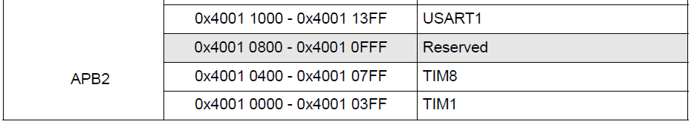
ARM Cortex-M
Work with registers
PERIPH_BASE = 0x4000 0000
APB2PERIPH_BASE = PERIPH_BASE + 0x0001 0000
TIM8_BASE = APB2PERIPH_BASE + 0x0400

Slide 20
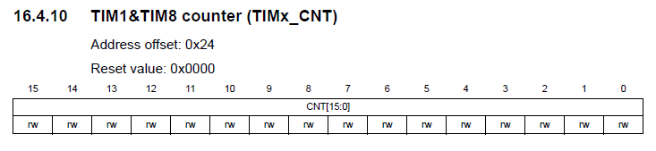
ARM Cortex-M
Work with registers
PERIPH_BASE = 0x4000 0000
APB2PERIPH_BASE = PERIPH_BASE + 0x0001 0000
TIM8_BASE = APB2PERIPH_BASE + 0x0400
TIM Counter = 0x24
tim_cnt = *((uint32_t *)(TIM8_BASE + 0x24));
tim_cnt = *((uint32_t *)(0x4001 0000 + 0x0400 + 0x24));

Slide 21
ARM Cortex-M
Work with registers
typedef struct
{
uint32_t el1;
uint32_t el2;
uint8_t el3;
uint8_t el4;
uint16_t el5;
uint32_t el6;
} STRUCT_NAME_TypeDef;
32 bit |  |  |  | Address offsets
16 bit |  | 16 bit
8 bit | 8 bit | 8 bit | 8 bit
el1 |  |  |  | 0x00
el2 |  |  |  | 0x04
el3 | el4 | el5 |  | 0x08 | 0x09 | 0x0A
el6 |  |  |  | 0x0C

Slide 22
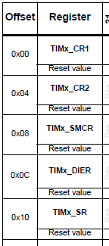
ARM Cortex-M
Work with registers
typedef struct
{
__IO uint32_t CR1;
__IO uint32_t CR2;
__IO uint32_t SMCR;
__IO uint32_t DIER;
__IO uint32_t SR;
...
} TIM_TypeDef;
#define TIM8 ((TIM_TypeDef *) TIM8_BASE)
tim_cnt = TIM8->CNT;
TIM8->CR1 = TIM_CR1_CEN;

Slide 23
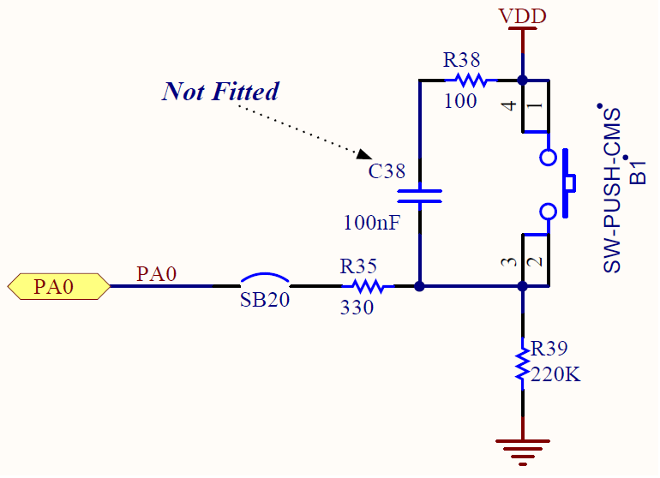
ARM Cortex-M
Example.
Task 1. Read button state
PERIPH_BASE = 0x40000000
AHB1_BASE = PERIPH_BASE + 0x00020000
GPIOA_BASE = AHB1_BASE + 0x0000
Input Data Reg = 0x10
button = GPIOA->IDR & 1 << 0;
button = *((uint32_t *)(0x40000000U + 0x00020000 + 0x10)) & 0x1;

Slide 24
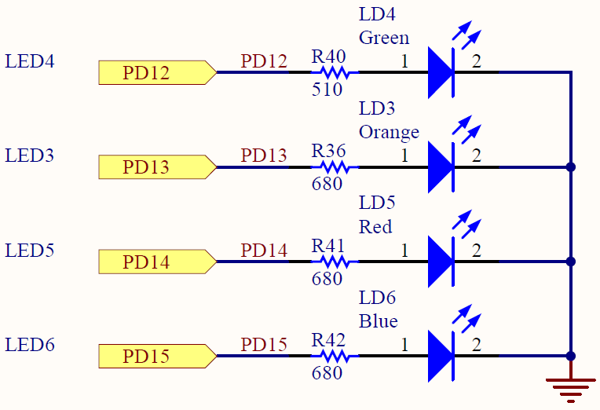
ARM Cortex-M
Example.
Task 2. Turn led On
PERIPH_BASE = 0x40000000
AHB1_BASE = PERIPH_BASE + 0x00020000
GPIOD_BASE = AHB1_BASE + 0x0C00
Output Data Reg = 0x14
Read -> Modify -> Write
GPIO->ODR = GPIO->ODR | 1 << 12;
GPIO->ODR |= 1 << 12;

Slide 25
ARM Cortex-M
Bit Banding
Address in the bit band alias region = Bit band alias base address + bit word offset
Where bit word offset = Byte offset from bit band base X32 + bit number X4
PERIPH_BASE = 0x40000000
&(GPIOD->ODR) = 0x40020C14
PERIPH_BB_BASE = 0x42000000
PIN = 12
BIT = PERIPH_BB_BASE + (&(GPIOD->ODR) – PERIPH_BASE)*32 + PIN*4
Byte offset from bit band base Bit number

Slide 26
ARM Cortex-M
Bit Banding. Example
define PD12 *((uint32_t *)(PERIPH_BB_BASE + ((uint32_t)&(GPIOD->ODR) - PERIPH_BASE)*32 + PIN*4))
PD12 = 1; PD12 = 0;
define PD ((uint32_t *)(PERIPH_BB_BASE + ((uint32_t)&(GPIOD->ODR) - PERIPH_BASE)*32)
PD[12] = 1; PD[13] = 0;
#define BIT(address, bit) *((uint32_t *)(PERIPH_BB_BASE + ((uint32_t)address - PERIPH_BASE)*32 + bit*4))
BIT(&GPIOD->ODR, 12) = 1; BIT(&GPIOD->ODR, 14) = 0;

Slide 27

Thank you for your attention
www.ifmo.ru

